Slide 1
Concurrency Control
Lock-based protocol

Slide 2
Transaction
The transaction is a set of logically related operation. It contains a group of tasks.
A transaction is a single logical unit of work which accesses and possibly modifies the contents of a database.
Transactions access data using read and write operations.
In order to maintain consistency in a database, before and after the transaction, certain properties are followed.

Slide 3
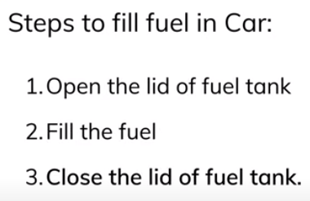
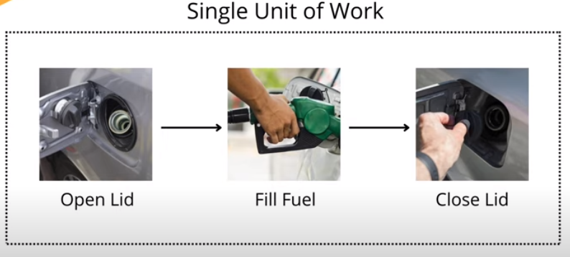
Can’t miss any of the single step

Slide 4
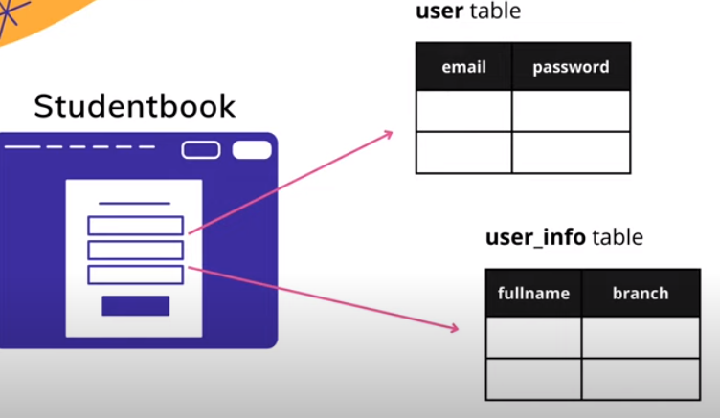

Slide 5
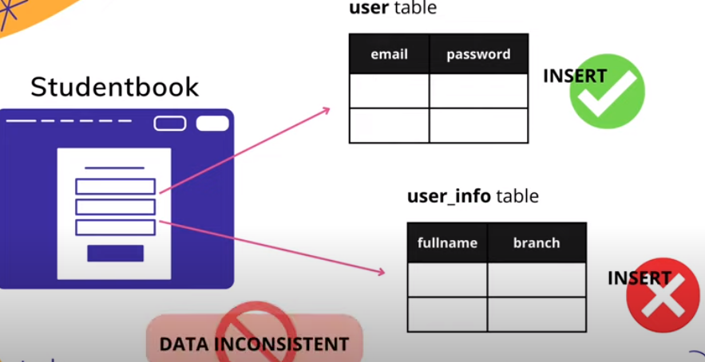
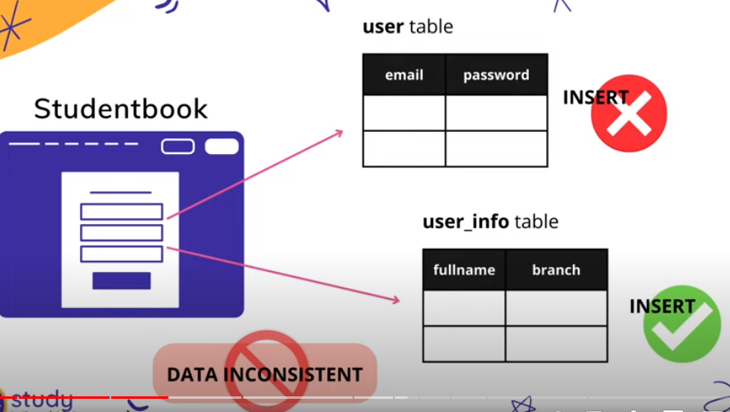
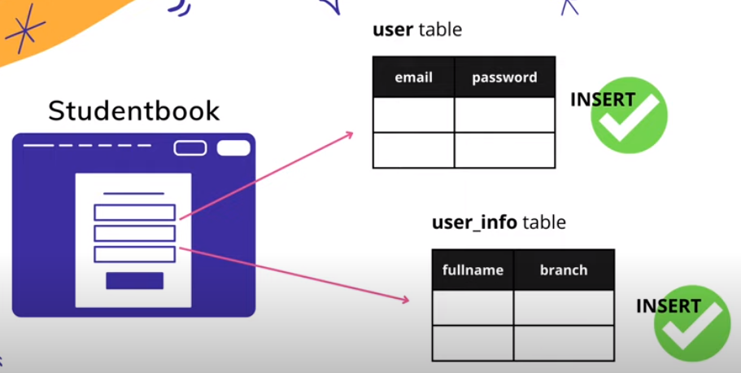
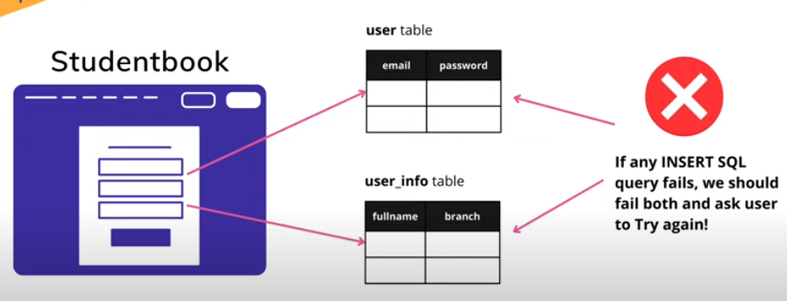
Both the queries to run successfully for successful transaction

Slide 6
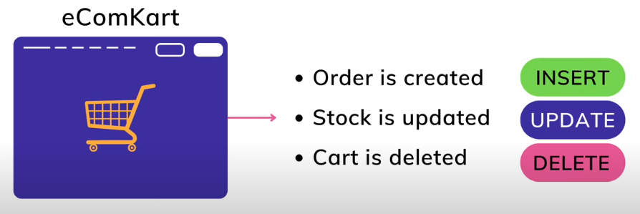
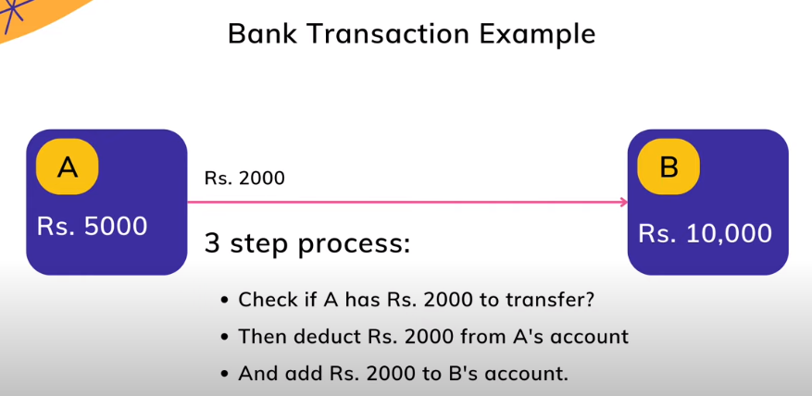

Slide 7
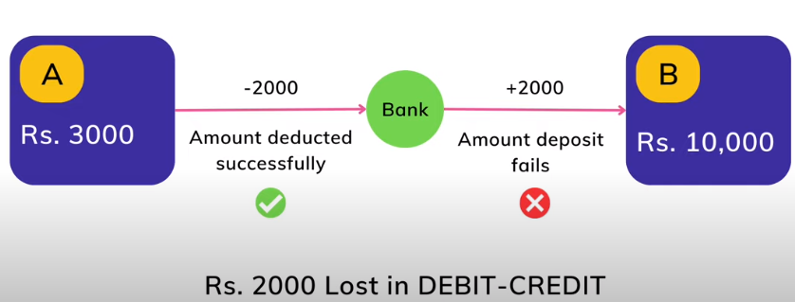
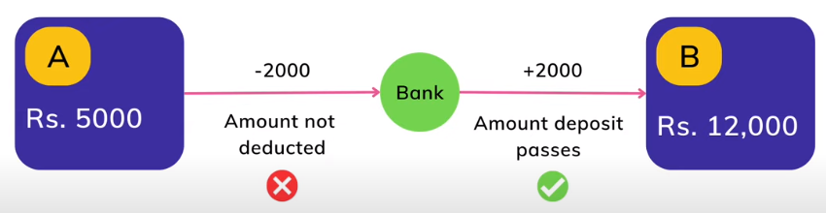

Slide 8
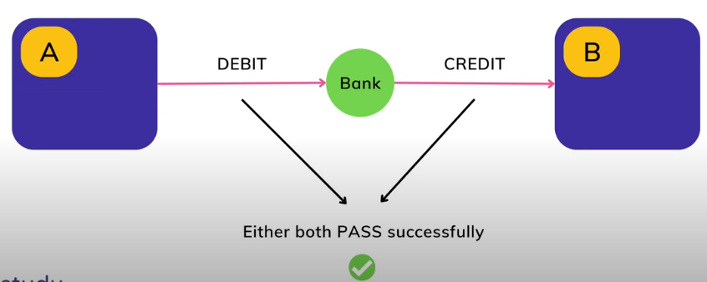
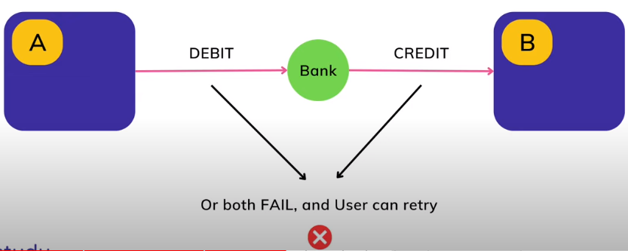

Slide 9
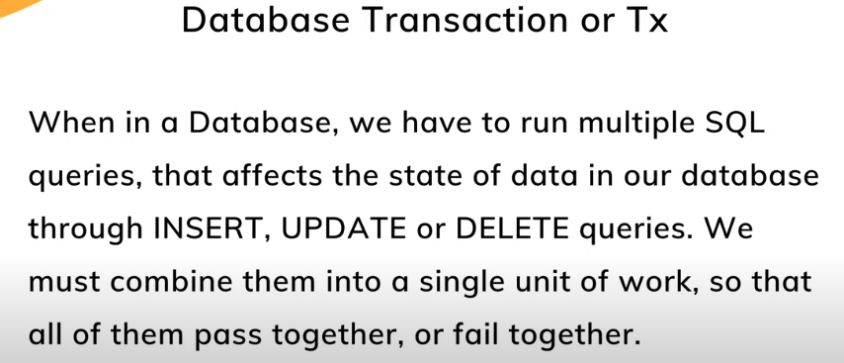
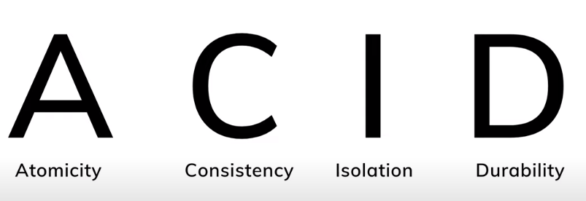

Slide 10
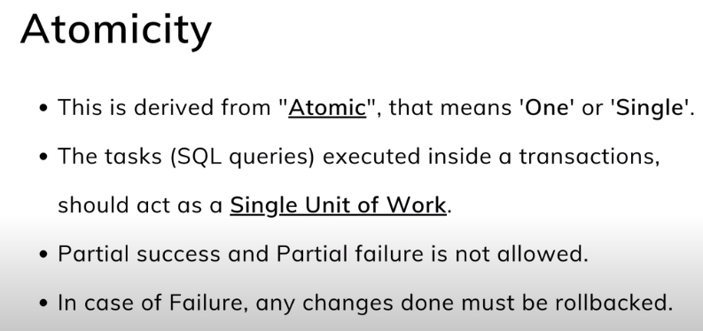
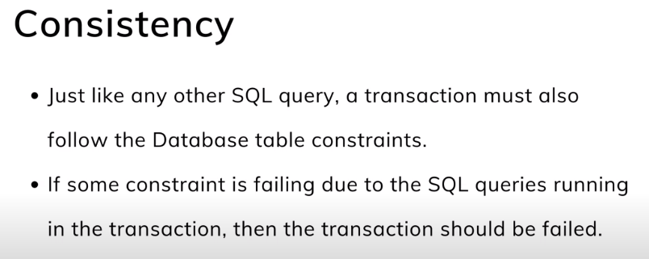
Example: Failure during A -> B
Ensuring consistency for an individual transaction is the responsibility of the app/ programmer through integrity constraint

Slide 11
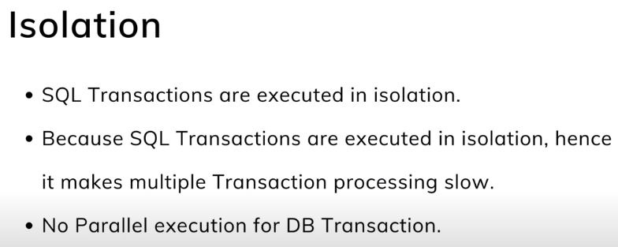
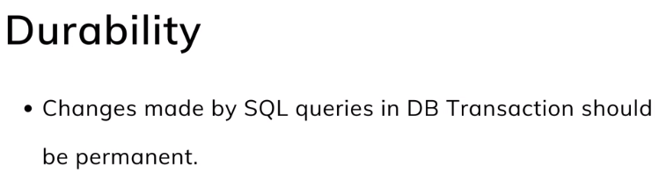
Example :
T1 : transferring fund 500 from A to B account.
Deducting 500 from A, adding 500 to B.
T2: Reading A and B for amount to be known
Have to isolate T1 from T2 for successful completion of the transferring amount and reading the amount status from both the account.
T1 need to be completed first and then T2
Updates carried out by the transaction have been written to disk before trans/. Completed.
Info/ about the update need to written to disk.(useful when restarted after failure

Slide 12
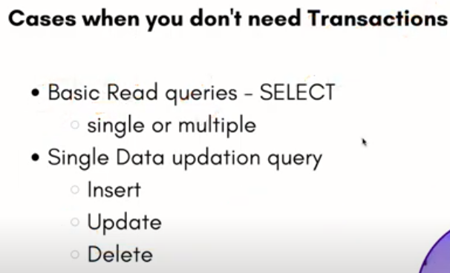
Not in all cases your applications needs standards of transaction

Slide 13
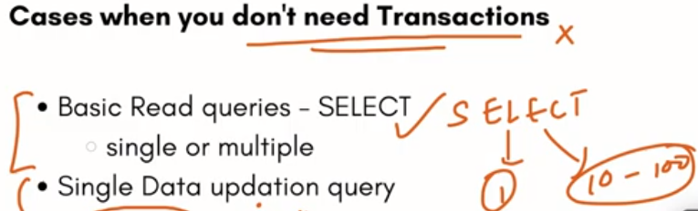
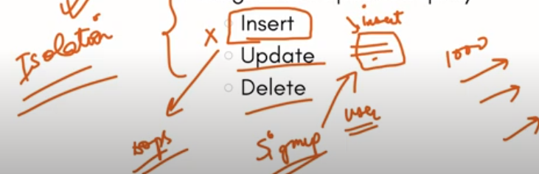
but this cannot be true in all cases.
Eg. Admin, user and product entity.
If admin tells after 12’clock 30% discount on the particular product will be updated. So user will be accessing the products to know the discount and buy the product.
so here it is of single update but any way needs to follow the stds of trans/ for consistent information to the user.

Slide 14
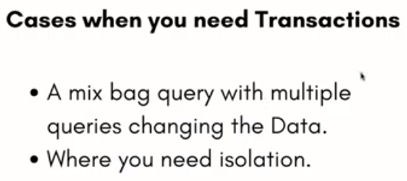
Example:
1.Read(A) -- 500 // Accessed from RAM. 2.A = A-50 // Deducting 50₹ from A. 3.Write(A) --450 // Updated in RAM. 4.Read(B) -- 800 // Accessed from RAM. 5.B=B+50 // 50₹ is added to B's Account. 6.Write(B) --850
For example: If in the above transaction, the debit transaction fails after executing operation 2 then A's value will remain 500 in the database which is not acceptable by the bank.
To solve this problem, we have two important operations:
Commit: It is used to save the work done permanently.
Rollback: It is used to undo the work done.
Read(X): Read operation is used to read the value of X from the database and stores it in a buffer in main memory.
Write(X): Write operation is used to write the value back to the database from the buffer.

Slide 15
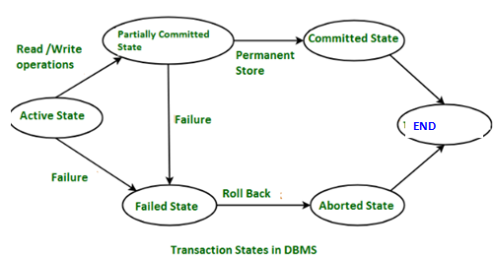
States of Transaction
A transaction must be in one of the following states:
Active State – When the instructions of the transaction are running then the transaction is in active state.
If all the ‘read and write’ operations are performed without any error then it goes to the “partially committed state”; if any instruction fails, it goes to the “failed state”.
Partially Committed – After completion of all the read and write operation the changes are made in main memory or local buffer.
If the changes are made permanent on the DataBase then the state will change to “committed state” and in case of failure it will go to the “failed state”.
Failed State – When any instruction of the transaction fails, it goes to the “failed state” or if failure occurs in making a permanent change of data on Data Base.
Aborted State – After having any type of failure the transaction goes from “failed state” to “aborted state” and since in previous states, the changes are only made to local buffer or main memory and hence these changes are deleted or rolled-back.
Committed State – It is the state when the changes are made permanent on the Data Base and the transaction is complete and therefore terminated in the “terminated state”.

Slide 16
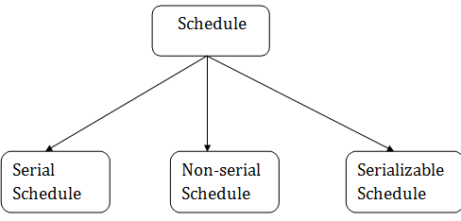
Schedule
A series of operation from one transaction to another transaction is known as schedule.
a sequence of operations in the chronological order in which such things are intended to take place
It is used to preserve the order of the operation in each of the individual transaction.
Transaction Isolation: Transaction processing system allow multiple transaction to run concurrently.
But cause several complications with consistency of data.
Easier method: make it serial: one at a time and each starting only after the previous one is completed.
2 good reasons for concurrency:
Improved throughput (no.of transactions executed at a given amount of time)and resource utilization (processor and disk – ie spend less time idle )
Reduced waiting time. (short and long transactions. Serial: short needs to wait for long to complete, so delays. Concurrency reduce the delays.)
concurrent
Concurrent to be serial
Note:
Chronological order:
an arrangement of events in the order of their happening or based on the time they have occurred.

Slide 17
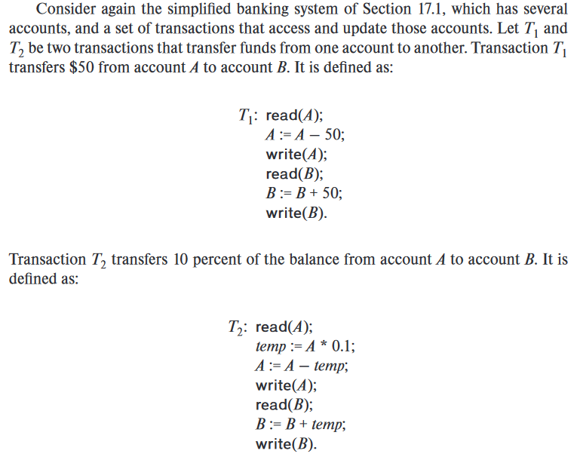

Slide 18
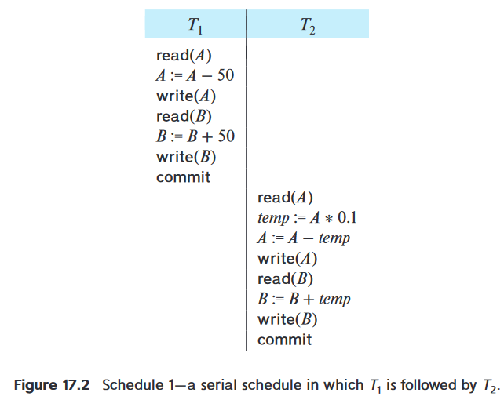
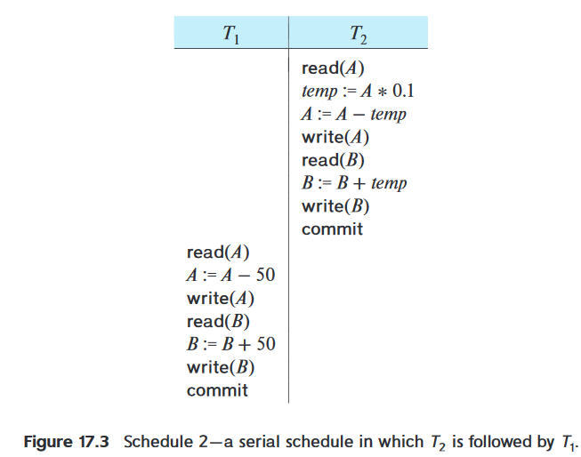
Assume ,
A=1000
B=2000
Total amount in account =3000
Suppose,
A=$1000
B=$2000
When DB sys/. Executes several trans. Concurrently, no need to be serial
Final value of A and B after schedule 1.
A=855
B=2145
Total amount of money in the account A+B is preserved.
This execution sequence of transaction is called schedules. Preserve the order in which the instructions appears
Final value of A and B after schedule 2.
A=850
B=2150
Total amount of money in the account A+B is preserved.

Slide 19
When the database system executes several transactions concurrently, the corresponding schedule no longer needs to be serial.
If two transactions are running concurrently, the OS may execute one transaction for a little while, then perform a context switch, execute the second transaction for some time, and then switch back to the first transaction for some time, and so on.
With multiple transactions, the CPU time is shared among all the transactions.
it is not possible to predict exactly - how many instructions of a transaction will be executed before the CPU switches to another transaction.

Slide 20
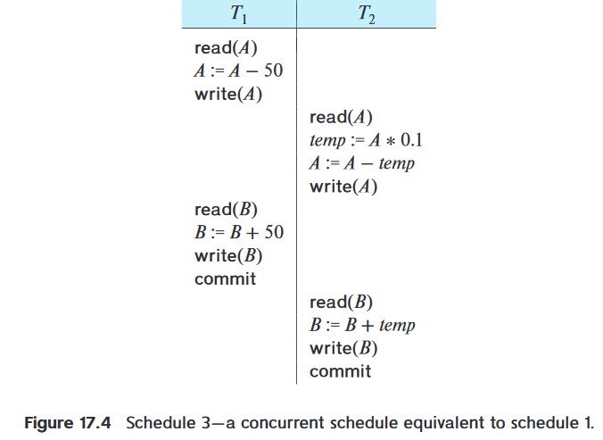
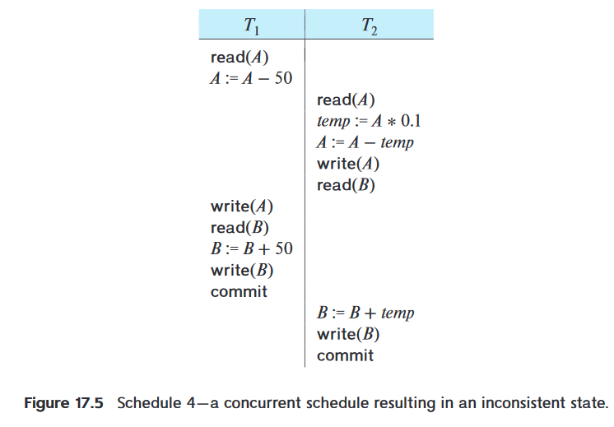
One possible schedule - Figure 17.4 arrive at the same state – as executed serially.
But ,not all concurrent executions result in a correct state.
17.5 - arrive at a state where the final values of accounts A and B are $950 and $2100, respectively.
This final state is an inconsistent state, since we have gained $50 in the process of the concurrent execution.
Indeed, the sum A + B is not preserved

Slide 21
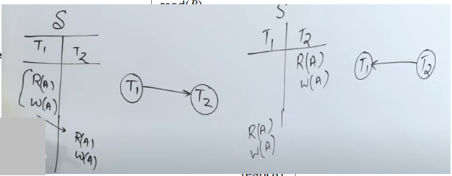
If control of concurrent execution is left entirely to the operating system, many possible schedules, including ones that leave the database in an inconsistent state, such as the one just described, are possible.
It is the job of the database system to ensure that any schedule that is executed will leave the database in a consistent state.
The concurrency-control component of the database system carries out this task.
Serializable:
Making concurrent transactions to be done serially.
Before we can consider how the concurrency-control component of the database system can ensure serializability, we consider how to determine when a schedule is serializable
Both schedule are serial and no interleaving.
Serial schedule cannot be serializable.

Slide 22
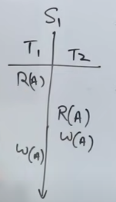
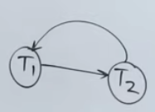
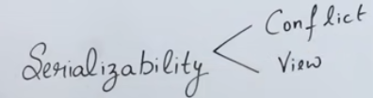
To check whether given parallel schedule be serializable or not.
Problems:
Given parallel schedule and convert to serial.
To convert this into serial :two ways
T1 -> T2
T2 -> T1
Does any equivalent serial schedule exist for this parallel schedule. That is called as serializable
Loop gets created
T1 -> T2
T2 -> T1
T1 | T2
R(A) W(A)
 | R(A) W(A)
T1 | T2
 | R(A) W(A)
R(A) W(A)

Slide 23
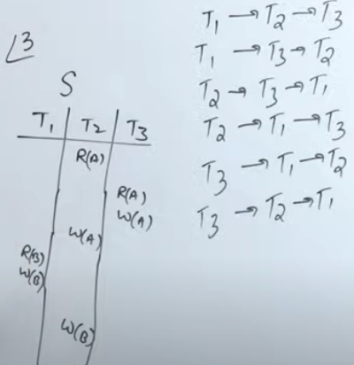
If three transactions are given and asked to find whether this is serializable or not.
For that take factorial of no.of transactions (n!) ie here no.of trsansactions n=3 T1,T2,T3, 3!=6 . 6 as below
While converting this schedule into serial and can able to bring out any one of this order from the 6 possibilities, then you can it is serializable.
ie equivalent to any one of the 6

Slide 24
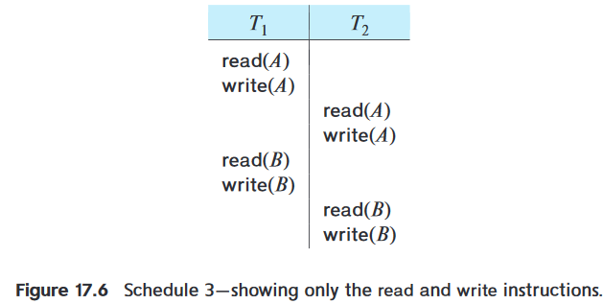
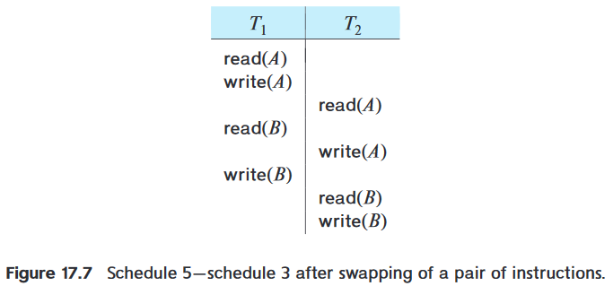

Slide 25
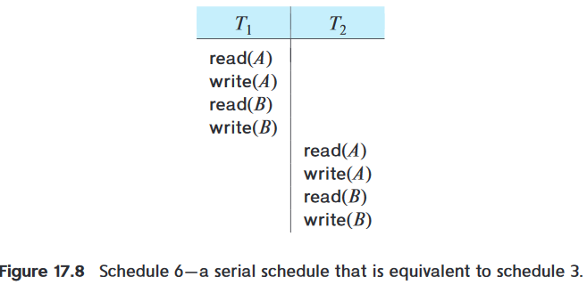
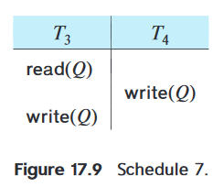

Slide 26
Conflict equivalence
Two schedules are said to be conflict equivalent if the order of two conflicting operations is the same in both the schedules.
Conditions to be satisfied for Conflicting operation:
Operations belongs to two different transactions.
They should be working or acting over same database item or variable.
Atleast one of the operation should be write.

Slide 27
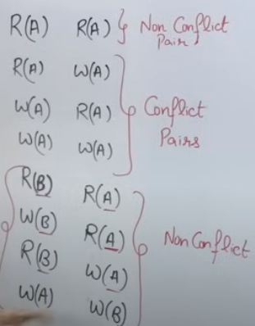
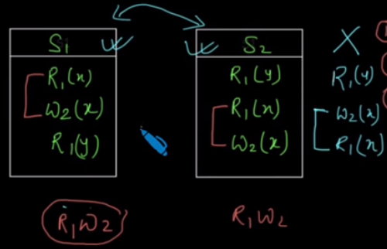
Two schedules

Slide 28
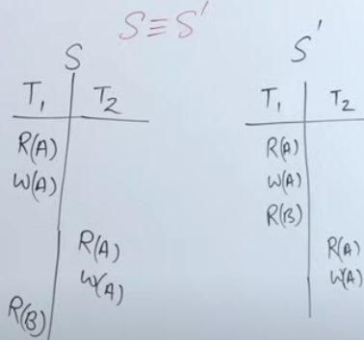
Check whether they are equivalent or not
R(A) and W(A) in both S ans S’ is same position. But R(B) changed.
Check adjacent non-conflict pairs.
If the pairs are non-conflict, then swap the position.
Again check for adjacent non-conflict pair.
Two schedules are said to be conflict equivalent when one can be transformed to another by swapping non-conflicting operations

Slide 29
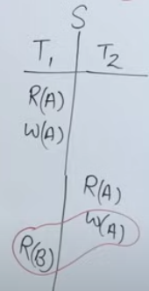
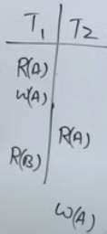
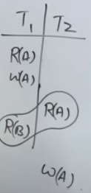
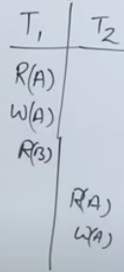
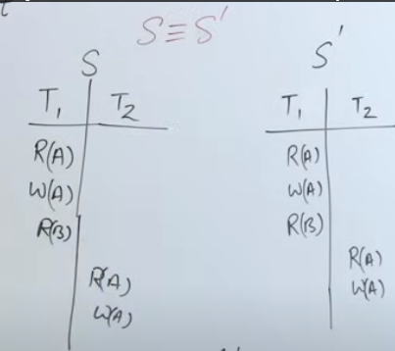
swap
Swap again
Non-conflict pairs
Non-conflict pairs
Now S and S’ are same ie they both are conflict equivalent schedule

Slide 30
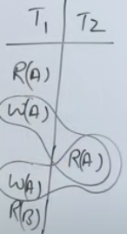
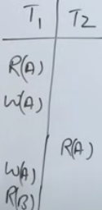
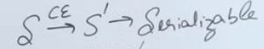
Check the equivalent schedule of this given schedule. Here no swapping(no change in positions) is needed between the adjacents bex already it is conflicting pairs

Slide 31





Conflict serializability
Check Whether given schedule is conflict serializable or not?
How to check it? – first draw precedence graph.(edges and vertices/nodes, vertices -transactions, edges- flow of conflict pairs)
How to draw the edges? Check conflict pairs in other transactions and draw the edges.
What is conflict pairs? R-W, W-R,W-W
To check, start from T1 having R(x) as first operation and check with other two transactions for W(x) ie conflict pair, but there is no W(x) in T2 and T3. so cancel R(x) from T1.
Next check R(y) from T3, no W(Y) in T1 and T2, so cancel it.
Check R(x) in T3, yes there is W(x) in T1, then draw the edges from t3 to T1

Slide 32






Slide 33

To serialize this 3 transaction, find 3!, so 6 possibilities are there as:
T1->T2->T3
T1->T3->T2
T2->T1->T3
T2->T3->T1
T3->T1->T2
T3->T2->T1
Among this graph is equivalent to which serial transaction?
To check this, go to the graph for Indegree =0 ,means find the vertices whose indegree is zero (no edges is towards that node)
In this example T2 indegree is 0, so first remove it.
After T3 has indegree 0, so remove it. (T2->T3)
After removing T3 only one node T1 will be there, and its indegree is now 0, so remove it. (T2->T3->T1)

Slide 34




View serializability
Check whether this is conflict serializable or not?
It is not a conflict seriablizable(ie. It is non-conflict serializable), because loop exist between T1 and T2.But can’t answer for whether it is serial.
So make use of second method called view serializable method
Little bit rearrange the schedule as given in 3rd diagram.check whether first and third are matching each other

Slide 35


They both are view equivalent and not conflict equivalent.
Here conflict serializable says it is not serializable but view says it is serializable.
If serializable is not achieved by conflict then go for view serializable
Conflict Serializability in DBMS checks if a non-serial schedule is conflict serializable or not. View Serializability checks if a schedule is view serializable or not. If a schedule is a view equivalent to a Serial Schedule, it is said to be view serializable.

Slide 36
Need of View-Serializability
There may be some schedules that are not Conflict-Serializable - but still gives a consistent result because the concept of Conflict-Serializability becomes limited when the Precedence Graph of a schedule contains a loop/cycle.
In such a case we cannot predict whether a schedule would be consistent or inconsistent.
As per the concept of Conflict-Serializability, We can say that a schedule is Conflict-Serializable (means serial and consistent) if its corresponding precedence graph does not have any loop/cycle.
But, what if a schedule’s precedence graph contains a cycle/loop and is giving consistent result/accurate results as a conflict serializable schedule is giving?
So, to address such cases we brought the concept of View-Serializability because we did not want to confine the concept of serializability only to Conflict-Serializability.

Slide 37



Recoverable Schedules
Always tow questions: serializability and recoverrability
Situation where we recover the data (old database state) after some failure of the schedule.
From the given schedule, find whether it is recoverable or irrecoverable? (ie whether the schedule is having the ability of getting recovered or not?
If T1 failed after R(B) due to h/w or s/w failure, then as per atomicity, back to first ie rollbacked to start of T1, so everything lost. So it is irrecoverable
B=20
5 in shared memory but in db( it is 10)
Once after committed, it gets stored or reflected in db (ie durability)

Slide 38

Cascading and cascadless schedule
This is dirty write- read. To avoid this perform rollback

Slide 39
Concurrency Control
In a multiprogramming environment where multiple transactions can be executed simultaneously, it is highly important to control the concurrency of transactions.
To ensure the system must control theinteraction among the concurrent transactions – through a mechanism concurrency control
We have concurrency control protocols to ensure atomicity, isolation, and serializability of concurrent transactions.
Concurrency control protocols can be broadly divided into two categories −
Lock based protocols
Time stamp based protocols

Slide 40
Lock-Based Protocols
One way to ensure isolation is to require that data items be accessed in a mutually exclusive manner; that is, while one transaction is accessing a data item, no other transaction can modify that data item.
The most common method - holding a lock on that item.
Locks:
two modes:
1. Shared.
2. Exclusive.
Shared lock: (lock-S)
It is also known as a Read-only lock. In a shared lock, the data item can only read by the transaction.
It can be shared between the transactions because when the transaction holds a lock, then it can't update the data on the data item.
Whenever a shared lock is used on a database, it can be read by several users, but these users who are reading the information or the data items will not have permission to edit it or make any changes to the data items.
If a transaction Ti has obtained a shared-mode lock (denoted by S) on item Q, then Ti can read, but cannot write, Q.
Exclusive lock: (lock-X)
In the exclusive lock or write lock, the data item can be both reads as well as written by the transaction.
This lock is exclusive, and in this lock, multiple transactions do not modify the same data simultaneously.
After finishing the 'write' step, transactions can unlock the data item.
If a transaction Ti has obtained an exclusive-mode lock (denoted by X) on item Q, then Ti can both read and write Q.

Slide 41

Lock Compatibility Matrix
Shared Lock can be held by any amount of transactions.
On the other hand, an Exclusive Lock can only be held by one transaction in DBMS.
this is because a shared lock only reads data but does not perform any other activities, whereas an exclusive lock performs read as well as writing activities.
Example:
when two transactions are involved, and both of these transactions seek to read a specific data item, the transaction is authorized, and no conflict occurs; but, in a situation when one transaction intends to write the data item and another transaction attempts to read or write simultaneously, the interaction is rejected.

Slide 42


Suppose that the values of accounts A and B are $100 and $200, respectively.
If these two transactions are executed serially,
either in the order T1, T2
or the order T2, T1,
then transaction T2 will display the value $300.
If, however, these transactions are executed concurrently, then schedule 1, in Figure 18.4 (next slide), is possible.
In this case, transaction T2 displays $250, which is incorrect. The reason for this mistake is that the transaction T1 unlocked data item B too early, as a result of which T2 saw an inconsistent state

Slide 43

A and B are $100 and $200, respectively. ,
transaction T2 displays $250
The schedule shows the actions executed by the transactions,
as well as the points at which the concurrency-control manager grants the locks.
Also infer when locks are granted.
Fig. schedule 1

Slide 44


Suppose now that unlocking is delayed to the end of the transaction.
Transaction T3 corresponds to T1 with unlocking delayed (Figure 18.5).
Transaction T4 corresponds to T2 with unlocking delayed (Figure 18.6).
You should verify that the sequence of reads and writes in schedule 1, which lead to
an incorrect total of $250 being displayed, is no longer possible with T3 and T4.

Slide 45

deadlock
Unfortunately, locking can lead to an undesirable situation.
Consider the partial schedule of Figure for T3 and T4.
T3 - holding an exclusive-mode lock on B
T4 - requesting a shared-mode lock on B
T4 is waiting for T3 to unlock B.
Similarly,
T4 - holding a shared-mode lock on A
T3 - requesting an exclusivemode lock on A
T3 is waiting for T4 to unlock A.
Thus, we have arrived at a state where neither of these transactions can ever proceed with its normal execution. This situation is called deadlock.
partial schedule of Figure for T3 and T4.

Slide 46
Granting of Locks
When a transaction requests a lock on a data item in a particular mode, and no other transaction has a lock on the same data item in a conflicting mode, the lock can be granted.
However, care must be taken to avoid the following scenario.
Suppose a transaction T2 has a shared-mode lock on a data item, and another transaction T1 requests an exclusive-mode lock on the data item.
T1 has to wait for T2 to release the sharedmode lock.
Meanwhile, a transaction T3 may request a shared-mode lock on the same data item.
The lock request is compatible with the lock granted to T2, so T3 may be granted the shared-mode lock.
At this point T2 may release the lock, but still T1 has to wait for T3 to finish.
But again, there may be a new transaction T4 that requests a shared-mode lock on the same data item, and is granted the lock before T3 releases it.
but T1 never gets the exclusive-mode lock on the data item. The transaction T1 may never make progress, and is said to be starved.
T2 – S(A)
T1 -> X(A) (need to wait)
T3 -> S(A) (compatible with T2) ,so T3- S(A)
T2 ---released the shared lock on A
T1 --- need to wait for T3 ‘s completion.
T4 -> S(A) (compatible with T3) ,so T4 - S(A)

Slide 47
avoid starvation
We can avoid starvation of transactions by granting locks in the following manner:
When a transaction Ti requests a lock on a data item Q in a particular mode M, the concurrency-control manager grants the lock provided that:
There is no other transaction holding a lock on Q in a mode that conflicts with M.
There is no other transaction that is waiting for a lock on Q and that made its lock request before Ti .

Slide 48
locking protocol
require that each transaction in the system follow a set of rules, called a locking protocol, indicating when a transaction may lock and unlock each of the data items.
Locking protocols restrict the number of possible schedules.
present several locking protocols that allow only conflict-serializable schedules, and thereby ensure isolation

Slide 49

Two-Phase Locking Protocol
One protocol that ensures conflict serializability is the two-phase locking protocol.
This protocol requires that each transaction issue lock and unlock requests in two phases:
1. Growing phase. A transaction may obtain locks, but may not release any lock.
2. Shrinking phase. A transaction may release locks, but may not obtain any new locks
The point in the schedule where the transaction has obtained its final lock (the end of its growing phase) is called the lock point of the transaction.
Two-phase locking has two phases, one is growing, where all the locks are being acquired by the transaction;
and the second phase is shrinking, where the locks held by the transaction are being released.
Locks are acquired by transaction
Locks are released by transaction

Slide 50
Serial Schedule: The serial schedule is a type of Schedule where one transaction is executed completely before starting another transaction.
Non-serial Schedule: In a Non-serial schedule, multiple transactions execute concurrently/simultaneously.
Conflict Serializable: A schedule is called conflict serializable if it can be transformed into a serial schedule by swapping non-conflicting operations.
Conflicting operations: Two operations are said to be conflicting if all conditions satisfy:
They belong to different transactions.
They operate on the same data item.
At Least one of them is a write operation.
Conflicting operations pair (R₁(A), W₂(A)) because they belong to two different transactions on same data item A and one of them is write operation.
Similarly, (W₁(A), W₂(A)) and (W₁(A), R₂(A)) pairs are also conflicting.
On the other hand, (R₁(A), W₂(B)) pair is non-conflicting because they operate on different data item.
Similarly, ((W₁(A), W₂(B)) pair is non-conflicting.

Slide 51

Two-phase locking does not ensure freedom from deadlock.
Observe that transactions T3 and T4 are two phase, but, in schedule 2 (Figure 18.7), they are deadlocked.
in addition to being serializable, schedules should be cascadeless.
Each transaction observes the two-phase locking protocol, but the failure of T5 after the read(A) step of T7 leads to cascading rollback of T6 and T7.
Cascading rollback may occur under two-phase locking.

Slide 52
Cascading rollback
when a transaction (T1) causes a failure and a rollback must be performed.
Other transactions dependent on T1's actions must also be rollbacked due to T1's failure, thus causing a cascading effect
A single transaction failure leads to a series of transaction rollbacks is called Cascading rollback.
Cascading rollbacks can be avoided by a modification of two-phase locking called the strict two-phase locking protocol.
This protocol requires not only that locking be two phase, but also that all exclusive-mode locks taken by a transaction be held until that transaction commits.

Slide 53
Another variant of two-phase locking is the rigorous two-phase locking protocol, which requires that all locks (both S and X) be held until the transaction commits.
refinement of the basic two-phase locking protocol,
which allows lock conversions.
a mechanism for upgrading a shared lock to an exclusive lock, and downgrading an exclusive lock to a shared lock.
We denote conversion from shared to exclusive modes by upgrade, and from exclusive to shared by downgrade.
Lock conversion cannot be allowed arbitrarily (randomly).
Rather, upgrading can take place in only the growing phase, whereas downgrading can take place in only the shrinking phase.

Slide 54
Implementation of Locking
Locking protocols are used in database management systems as a means of concurrency control.
Multiple transactions may request a lock on a data item simultaneously.
Hence, we require a mechanism to manage the locking requests made by transactions. Such a mechanism is called as Lock Manager.
It relies on the process of message passing where transactions and lock manager exchange messages to handle the locking and unlocking of data items.

Slide 55
Data structure used in Lock Manager – The data structure required for implementation of locking is called as Lock table.
It is a hash table where name of data items are used as hashing index.
Each locked data item has a linked list associated with it.
Every node in the linked list represents the transaction which requested for lock, mode of lock requested (mutual/exclusive) and current status of the request (granted/waiting).
Every new lock request for the data item will be added in the end of linked list as a new node.
Collisions in hash table are handled by technique of separate chaining.

Slide 56

Explanation: In the above figure, the locked data items present in lock table are 5, 47, 167 and 15.
The transactions which have requested for lock have been represented by a linked list shown below them using a downward arrow.
Each node in linked list has the name of transaction which has requested the data item like T33, T1, T27 etc.
The colour of node represents the status i.e. whether lock has been granted or waiting.

Slide 57
Working of Lock Manager –
Initially the lock table is empty as no data item is locked.
Whenever lock manager receives a lock request from a transaction T_{i} on a particular data item Q_{i} following cases may arise:
If Q_{i} is not already locked, a linked list will be created and lock will be granted to the requesting transaction T_{i}.
If the data item is already locked, a new node will be added at the end of its linked list containing the information about request made by T_{i}.
If the lock mode requested by T_{i} is compatible with lock mode of transaction currently having the lock, T_{i} will acquire the lock too and status will be changed to ‘granted’. Else, status of T_{i}’s lock will be ‘waiting’.
If a transaction T_{i} wants to unlock the data item it is currently holding, it will send an unlock request to the lock manager. The lock manager will delete T_{i}’s node from this linked list. Lock will be granted to the next transaction in the list.
Sometimes transaction T_{i} may have to be aborted. In such a case all the waiting request made by T_{i} will be deleted from the linked lists present in lock table. Once abortion is complete, locks held by T_{i} will also be released.

Slide 58

Graph Based Concurrency Control Protocol
another way of implementing Lock Based Protocols.
Tree Based Protocols is a simple implementation of Graph Based Protocol.
A prerequisite of this protocol is that we know the order to access a Database Item.
For this we implement a Partial Ordering on a set of the Database Items (D) {d₁, d₂, d₃, ….., d_{n}} . The protocol following the implementation of Partial Ordering is stated as-
If d_{i} –> d_{j} then any transaction accessing both d_{i} and d_{j} must access d_{i} before accessing d_{j}.
Implies that the set D may now be viewed as a directed acyclic graph (DAG), called a database graph.
Tree Based Protocol –
Partial Order on Database items determines a tree like structure.
Only Exclusive Locks are allowed.
The first lock by T_{i} may be on any data item. Subsequently, a data Q can be locked by T_{i} only if the parent of Q is currently locked by T_{i}.
Data items can be unlocked at any time.

Slide 59

Multiple Granularity
Granularity – It is the size of the data item allowed to lock.
Now Multiple Granularity means hierarchically breaking up the database into blocks that can be locked and can be tracked needs what needs to lock and in what fashion.
Such a hierarchy can be represented graphically as a tree.
the levels starting from the top level are:
database
area
file
record

Slide 60
it shall use shared and exclusive lock modes.
When a transaction locks a node, in either shared or exclusive mode, the transaction also implicitly locks all the descendants of that node in the same lock mode.
For example, if transaction T_{i} gets an explicit lock on file F_{c} in exclusive mode, then it has an implicit lock in exclusive mode on all the records belonging to that file.
It does not need to lock the individual records of F_{c} explicitly.
introduce a new lock mode, called Intention lock mode.
Intention Mode Lock – In addition to S and X lock modes, there are three additional lock modes with multiple granularities:
Intention-Shared (IS): explicit locking at a lower level of the tree but only with shared locks.
Intention-Exclusive (IX): explicit locking at a lower level with exclusive or shared locks.
Shared & Intention-Exclusive (SIX): the subtree rooted by that node is locked explicitly in shared mode and explicit locking is being done at a lower level with exclusive mode locks.

Slide 61

Compatibility matrix
It requires that a transaction T_{i} that attempts to lock a node must follow these protocols:
Transaction T_{i} must follow the lock-compatibility matrix.
Transaction T_{i} must lock the root of the tree first, and it can lock it in any mode.
Transaction T_{i} can lock a node in S or IS mode only if T_{i} currently has the parent of the node-locked in either IX or IS mode.
Transaction T_{i} can lock a node in X, SIX, or IX mode only if T_{i} currently has the parent of the node-locked in either IX or SIX modes.
Transaction T_{i} can lock a node only if T_{i} has not previously unlocked any node (i.e., T_{i} is two-phase).
Transaction T_{i} can unlock a node only if T_{i} currently has none of the children of the node-locked.
Observe that the multiple-granularity protocol requires that locks be acquired in top-down (root-to-leaf) order, whereas locks must be released in bottom-up (leaf to-root) order.

Slide 62
Say transaction T₁ reads record R_{a2} in file F_{a}. Then, T₁ needs to lock the database, area A₁, and F_{a} in IS mode (and in that order), and finally to lock R_{a2} in S mode.
Say transaction T₂ modifies record R_{a9} in file F_{a} . Then, T₂ needs to lock the database, area A₁, and file F_{a} (and in that order) in IX mode, and at last to lock R_{a9} in X mode.
Say transaction T₃ reads all the records in file F_{a}. Then, T₃ needs to lock the database and area A₁ (and in that order) in IS mode, and at last to lock F_{a} in S mode.
Say transaction T₄ reads the entire database. It can do so after locking the database in S mode.

Slide 63
Timestamp Ordering Protocol
The Timestamp Ordering Protocol is used to order the transactions based on their Timestamps. The order of transaction is nothing but the ascending order of the transaction creation.
A timestamp is a unique identifier that is being created by the DBMS when a transaction enters into the system.
The priority of the older transaction is higher that's why it executes first.
To determine the timestamp of the transaction, this protocol uses system time or logical counter.
The lock-based protocol is used to manage the order between conflicting pairs among transactions at the execution time. But Timestamp based protocols start working as soon as a transaction is created.
Let's assume there are two transactions T1 and T2. Suppose the transaction T1 has entered the system at 007 times and transaction T2 has entered the system at 009 times. T1 has the higher priority, so it executes first as it is entered the system first.
The timestamp ordering protocol also maintains the timestamp of last 'read' and 'write' operation on a data.
For example, let’s say an old transaction T1 timestamp is TS(T1) and a new transaction T2 enters into the system, timestamp assigned to T2 is TS(T2). Here TS(T1) < TS(T2) so the T1 has the higher priority because its timestamp is less than timestamp of T2. T1 would be given the higher priority than T2. This is how timestamp based protocol maintains the serializability order.

Slide 64

A conflict occurs when an older transaction tries to read/write a value already read or written by a younger transaction. Read or write proceeds only if the last update on that data item was carried out by an older transaction.
Conflict is resolved by rolling back and restarting transactions.

